Slide 1
First try of ROCm Platform & HIP model

Slide 2

Li, Zongze
3rd Year Undergraduate, Shanghai Tech University
Major in Computer Science
Skills : Linux, Cmake, Configure, Pytorch, C/C++, Python, SQL, Matlab, Multisim…
Experience
Third-place of ISC 23 supercomputing competition
Teaching Assistant of Computer Architecture and Operation System class.
Participate in a research on the design of a P-MEM file system on campus

Slide 3
Outline
ROCm and HIP model
Hipify demo
ROCm_PyTorch demo

Slide 4
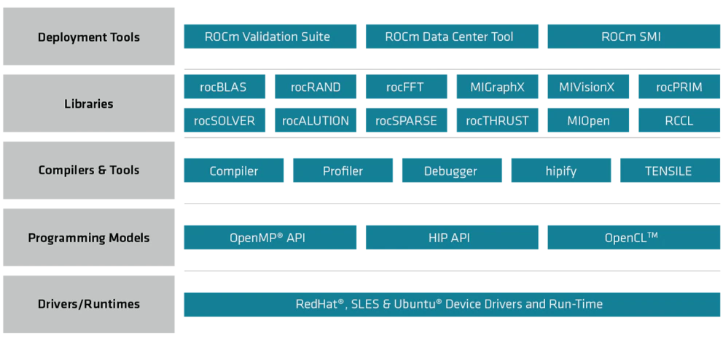
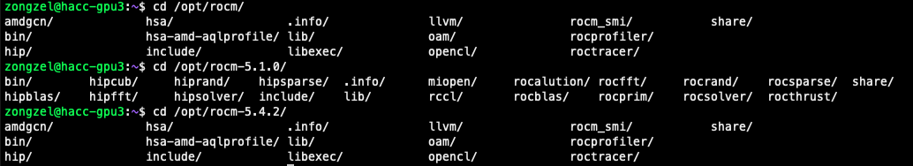
What is Rocm
ROCm (Radeon Open Compute) is an open source software platform designed to provide a general-purpose, high-performance computer programming environment for developing accelerated applications on AMD GPUs and CPUs.

Slide 5
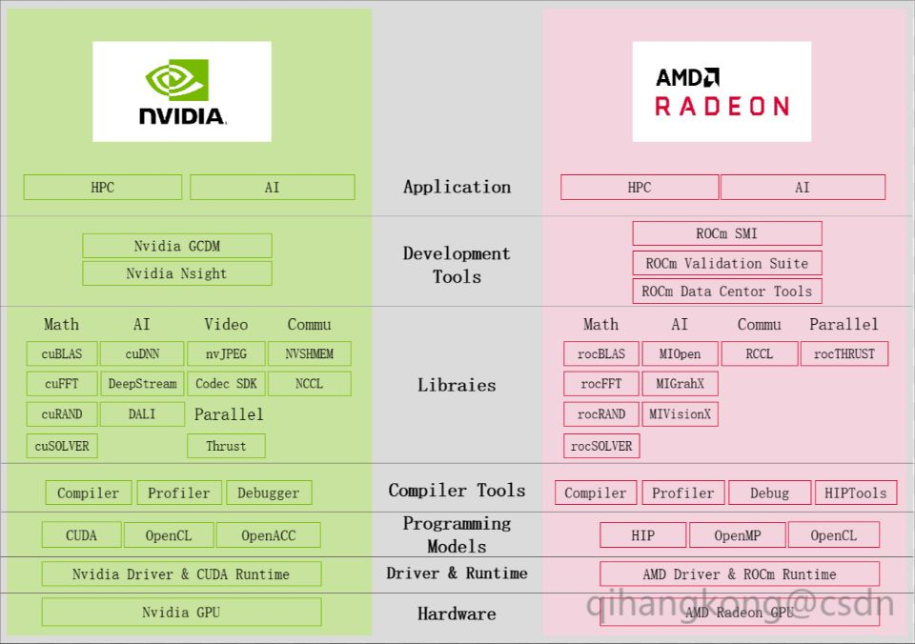
NVIDIA vs. AMD

Slide 6
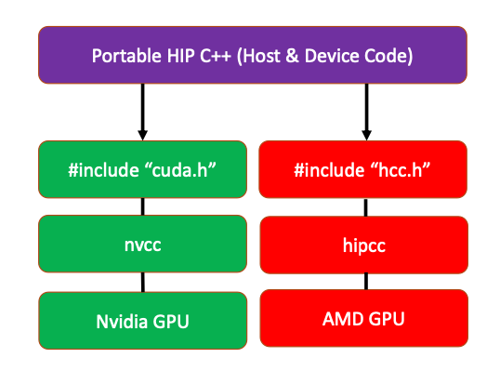
What is HIP
HIP (Heterogeneous-Compute Interface for Portability) is an open-source programming model from AMD that allows developers to write code once that can be compiled and executed on both CPUs and GPUs.
To be more specific, HIP is a C++ Runtime API and kernel language that allows developers to create portable applications for AMD and NVIDIA GPUs from a single source code.
HIP can compile code into intermediate code that can be executed on both CPUs and GPUs, and dynamically call the corresponding functions based on the device type at runtime. Therefore, developers can use HIP to write code once and deploy it on different devices, simplifying code development and maintenance.
In HIP model, the part run on CPU called host, the part run on accelerator(GPU) called device.
Host part code is CPU code. Entry function is main(). Hip use Runtime API allocate device memory, manage memory copy on host and device, run core function on device…
Device part is accelerator. It’s code run on GPU. The code is Extensive - C/C++. Essential part is core function.

Slide 7
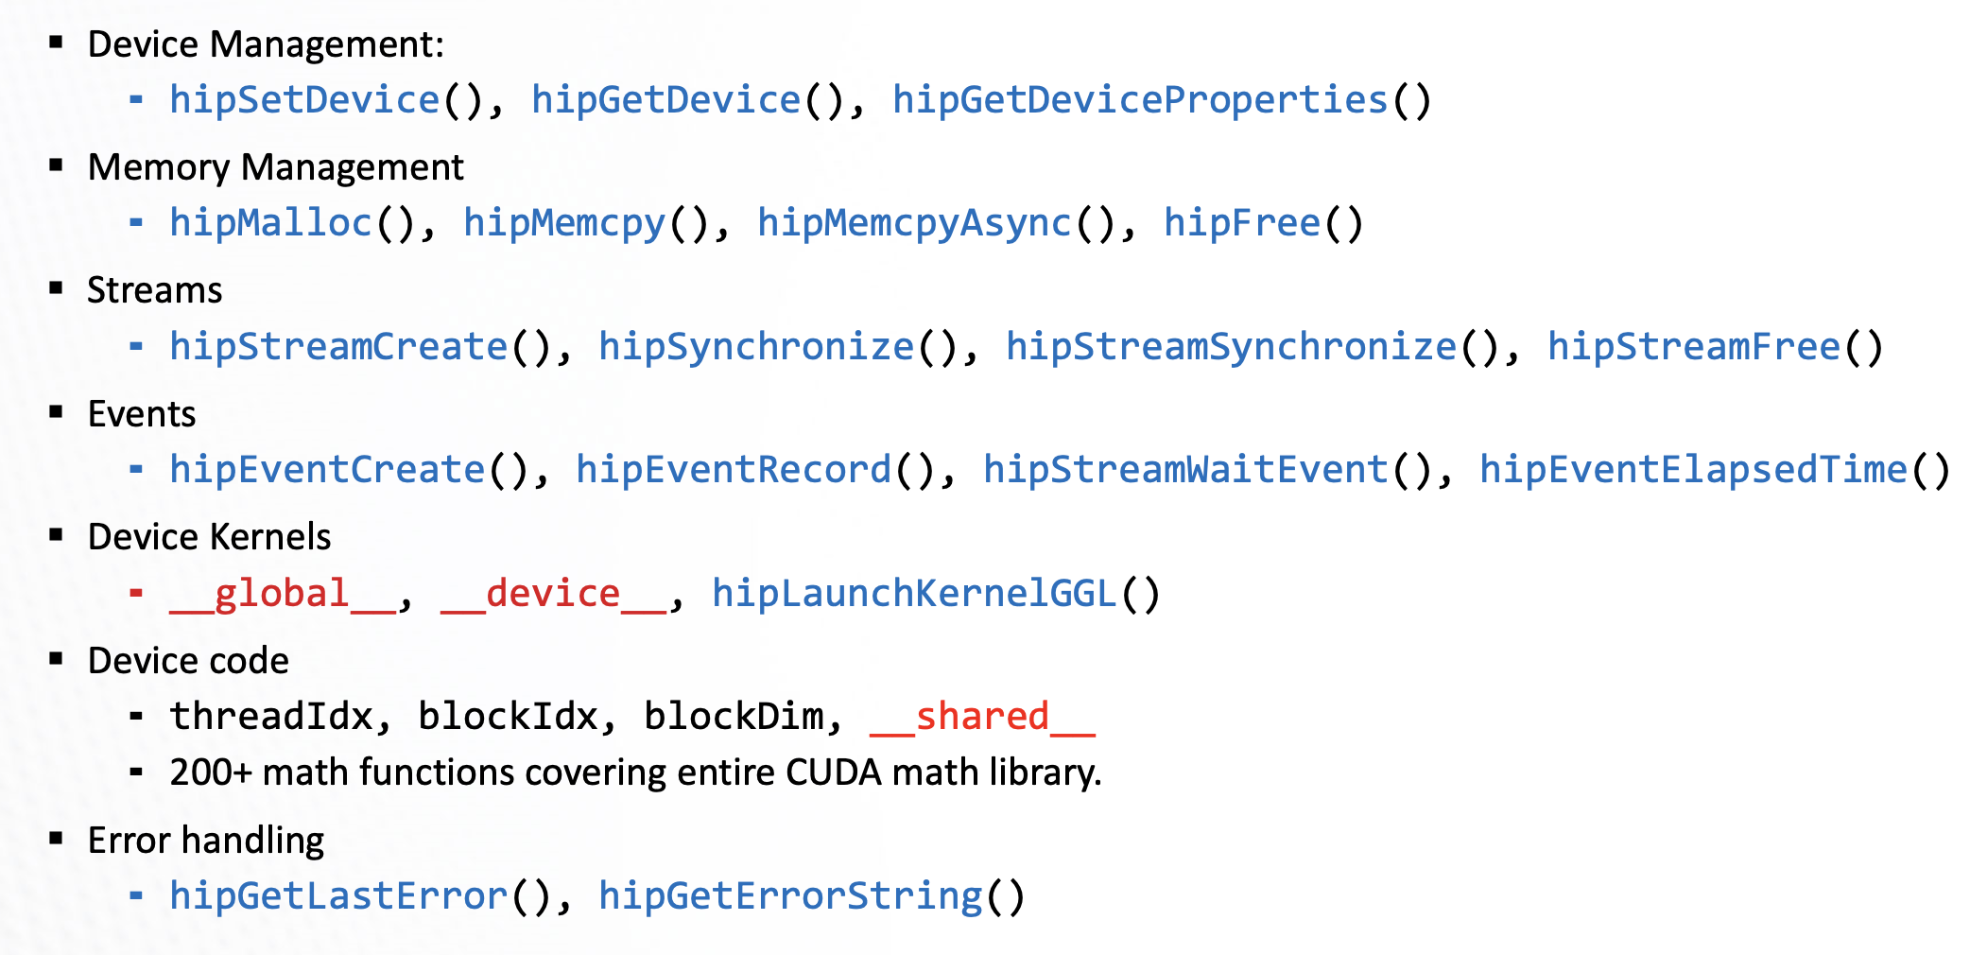
HIP API

Slide 8
Simple HIP programming example
Check if the ROCm environment :
/opt/rocm/bin/rocminfo
Check if the HIP environment :
/opt/rocm/bin/hipconfig --cpp_config
Here is HIP programing sample source :
https://github.com/ROCm-Developer-Tools/HIP/tree/main/samples

Slide 9
Kernel Function
▪ A device function that will be launched from the host program is called a kernel and is declared with the __global__ attribute
▪ Kernels should be declared void
▪ All threads execute the kernel’s body “simultaneously”
▪ Each thread uses its unique thread and block IDs to compute a global ID

Slide 10
Demo Part

Slide 11
vdd.cu
vdd.cpp
hipify-perl vdd.cu -o vdd.cpp

Slide 12
vdd.cpp
vdd_hip.cpp

Slide 13
The differences between CUDA version PyTorch (Traditional PyTorch) and ROCm PyTorch:
Kernel Function Language
Compilation and Build System
Underlying Library Calls
Platform-Specific Code
The relation between CUDA version PyTorch (Traditional PyTorch) and ROCm PyTorch:
The ROCm version of PyTorch is not completely independent of CUDA. Although ROCm PyTorch is an optimized version for running on AMD GPUs, it still has dependencies and associations with CUDA.

Slide 14
Cifar-100 ResNet demo

Slide 17
Thank you !

Slide 18
Integrative Example

